Slide 1

“HOW A NON CODER CAN MAKE A CAREER IN DATA SCIENCE”

Slide 2
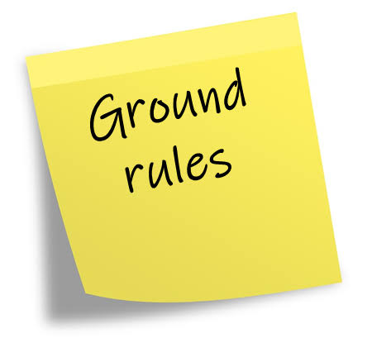
No Spamming on the chat window
Questions should be relevant to the current topic
Phones to be switched off
Note down the important points on a notepad

Slide 3

Experience-
Assistant Manager, Data Scientist at Deloitte India
Former Data Scientist at Accenture
Data Science Mentor at Datafolkz
Sreemanta Kesh
DataFolkz Mentor
Education-
Bachelor of Technology- BTech, Civil Engineering.

Slide 4
SESSION AGENDA
About me
Journey from a non coder to Data Scientist
Road Map in Becoming a Data Scientist
How much coding is required
Sample set of questions you are expected to solve in daily life
Questions
Datafolkz is here to help

Slide 5
About Me
Graduated as a Civil Engineer in the Year 2015
Placed at Accenture from college
Satarted working as Software Tester. Hated my Job.
Decided to prepare for CAT
Two failed attempts 2016 and 2017

Slide 6
About Me
MBA was my only plan. What next now?

Slide 7
My Data Science Journey
By now, I had decided to continue working in the IT Industry as by the time of two failed attempts I’d already had 2+ years of experience in the Industry
2018 January – Started reaching out to my friends. How to learn code. What to learn and from where to learn
2018 Feb – Started learning Python. Wrote my first code
2018 Feb –December – Learning Data Science by following Data Scientsits of Facebook/Google in LinkedIn. Was lucky enough to get an internship where I learned the actualy application of these concepts
2019 Jan – Internship Over. How do I keep learning and stay updated?
How do I target a DS Job?

Slide 8

Data Science RoadMap 2022
Learning Timeline -
4-6 months
Anything between 10–12 hrs a week stretched for continuous 18–20 weeks should be enough. Remember consistency is the key, remaining consistent can be a big challenge and this where most learners break.
In this case, you don't have the burden of working 6–8hrs a day and you can devote more time to learning. If you can manage 20+ hrs week 10–12 weeks you should be ready and if you are choosing a training program select one that fits this timeline.

Slide 9

Data Science RoadMap 2022
Data Science Skill Set
Here’s the list of skills you should acquire before applying for a Data Science job:
1. Python
2. Statistics and Machine Learning
3. One Data Viz. Tool – Tableau/Powe BI
4. SQL
4. SQL
5. Exposure to at least one cloud platforms from AWS/Azure/GCP (good to have)
6. Exposure to at least one web frameworks Flask/Django (good to have)

Slide 10

How much coding is required?
Short Answer – Not very extensive. Certainly not extensive if you are just starting up
Long Answer – There’s no escaping code. You need to be good at coding to make sure your projects are automated and scalable. This diffrentaites from a good data scientists to a great one.

Slide 11
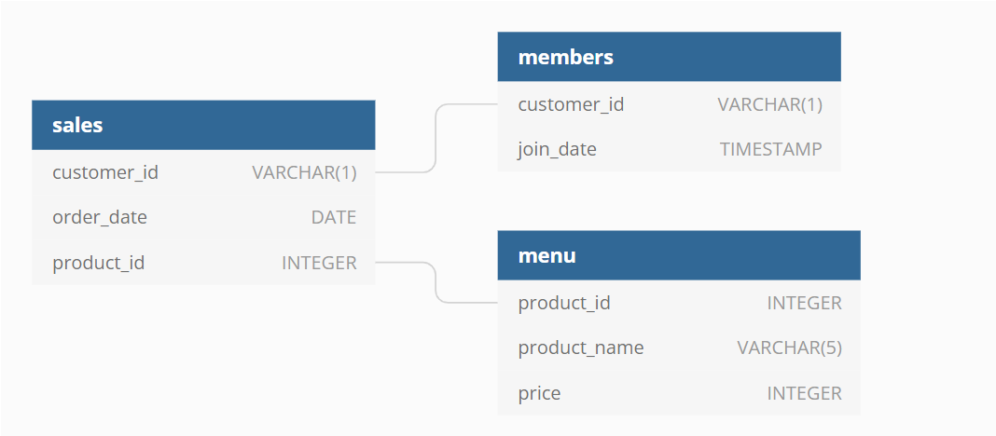
Sample set of questions you are expected to solve in daily life
What is the total amount each customer spent at the restaurant?
How many days has each customer visited the restaurant?
What was the first item from the menu purchased by each customer?

Slide 12
Questions ?

